Slide 1
LESSON 7 TURING ACCEPTORS VS TURING DECIDERS
CSc 304
Stephen Lucci

Slide 2
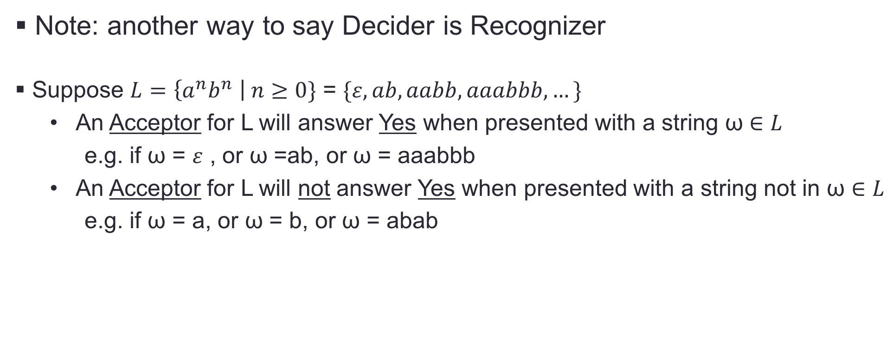
Turing Acceptors vs Turing Deciders

Slide 3
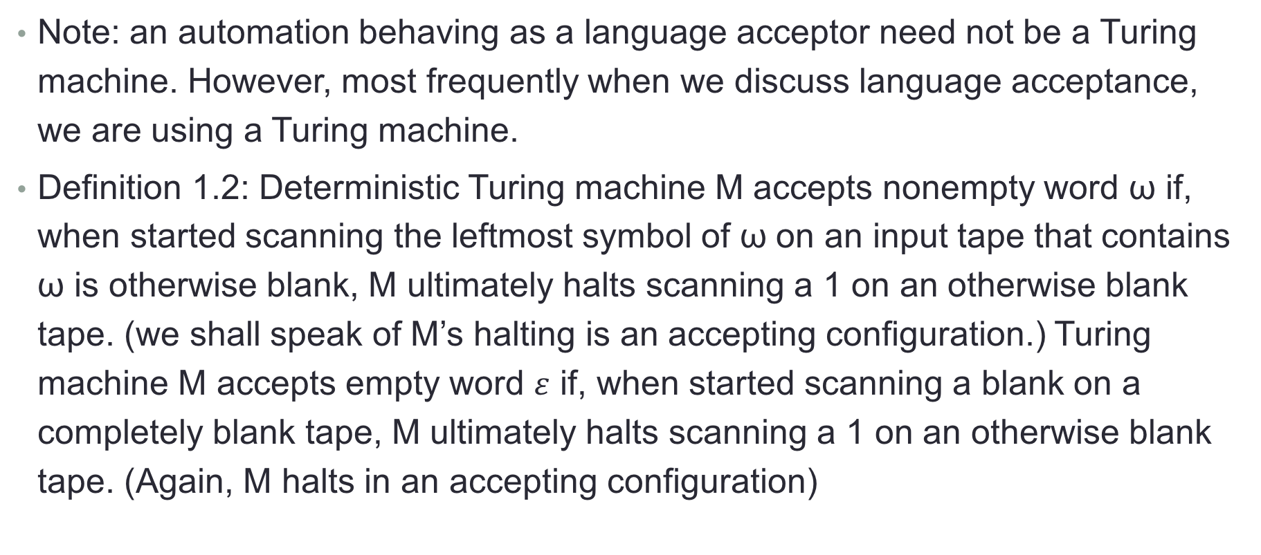
Turing Acceptors vs Turing Deciders

Slide 4
Turing Acceptors vs Turing Deciders
Definition 1.3: Deterministic Turing machine M accepts language L if M accepts all and only the words ω in L. Furthermore, we shall write L(M) for the language accepted by Turing machine M. So if Turing machine M accepts language L, then L(M) = L. A language L is said to be Turing-acceptable if there exists some deterministic Turing machine M that accepts L.

Slide 5
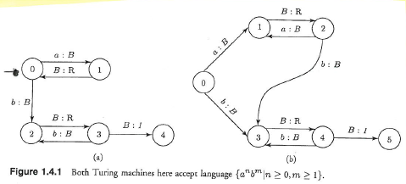
Example using figure 1.4.1
Note: Both machines accept the same Language
Let’s concentrate on Figure 1.4.1(a)
Let ω = b, we have qb |-- q2B |-- Bq3B |-- q41, M has halted with ‘1’ on a o.w. blank tape
M will respond similarly for the strings: b, aab, abb, bbb

Slide 6
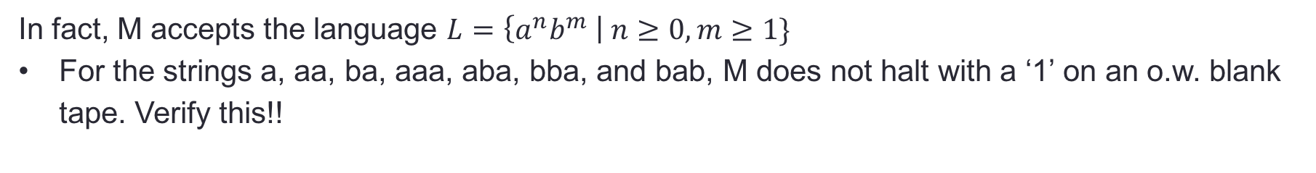
Example using figure 1.4.1 cont’d

Slide 7
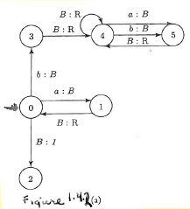
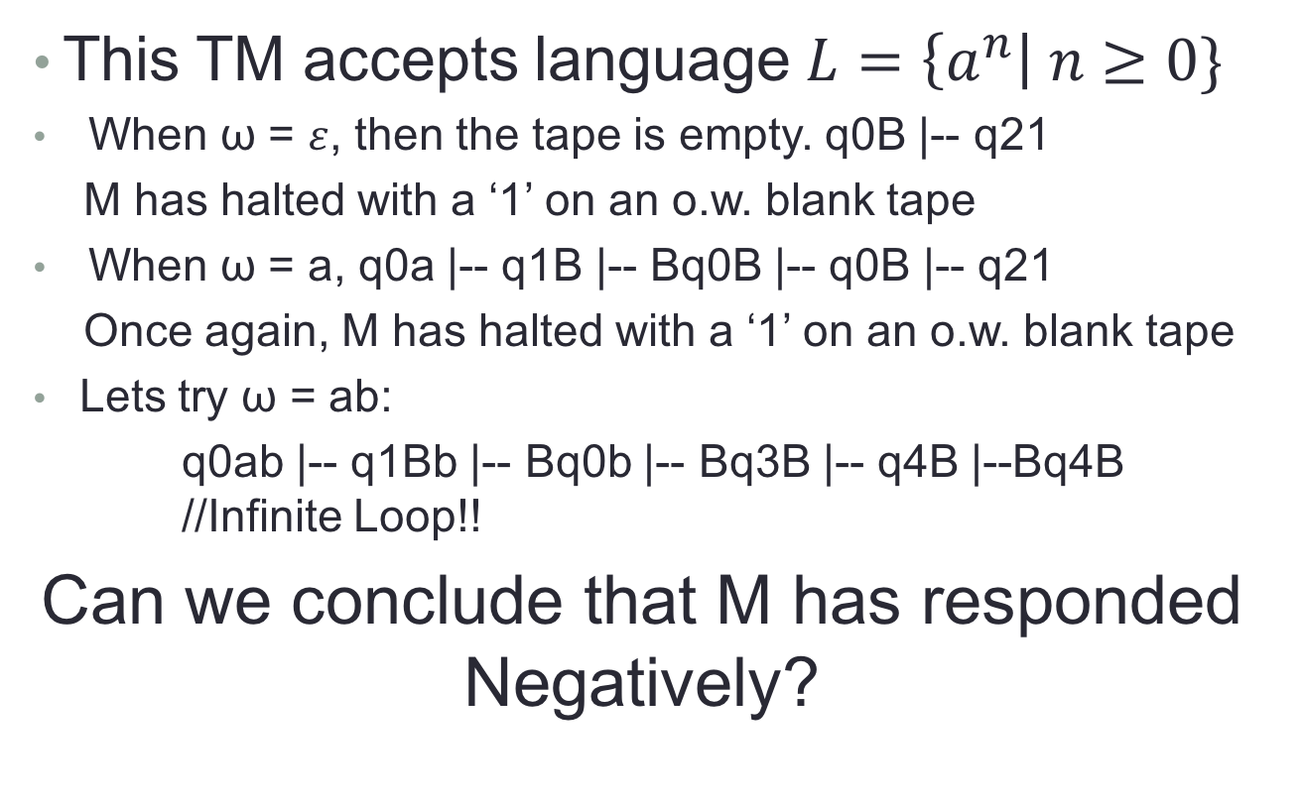
Example using figure 1.4.2 (a)

Slide 8
Example using figure 1.4.2 (a) cont’d
Can we conclude that M has responded Negatively?
Generally, we are not privy to the language expression & do not have access to M’s Program
We know the input string ω and we may view M’s R/W head.
How, then do we know that M will not eventually halt with a ‘1’ on an o.w. blank tape? WE DON”T!!

Slide 9
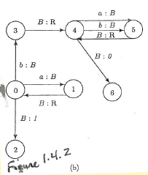
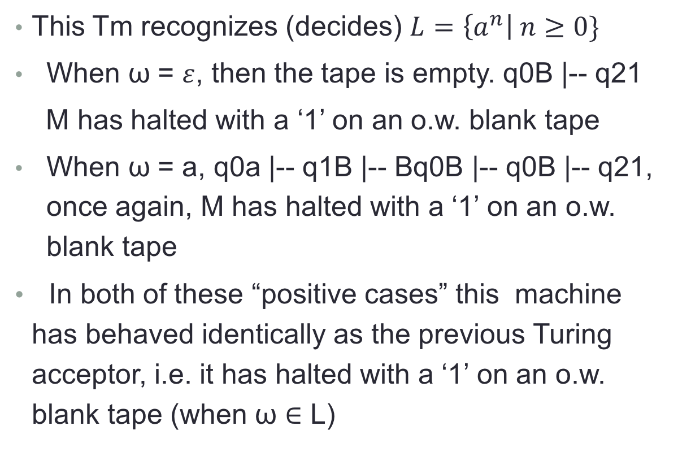
Example using figure 1.4.2 (b)

Slide 10
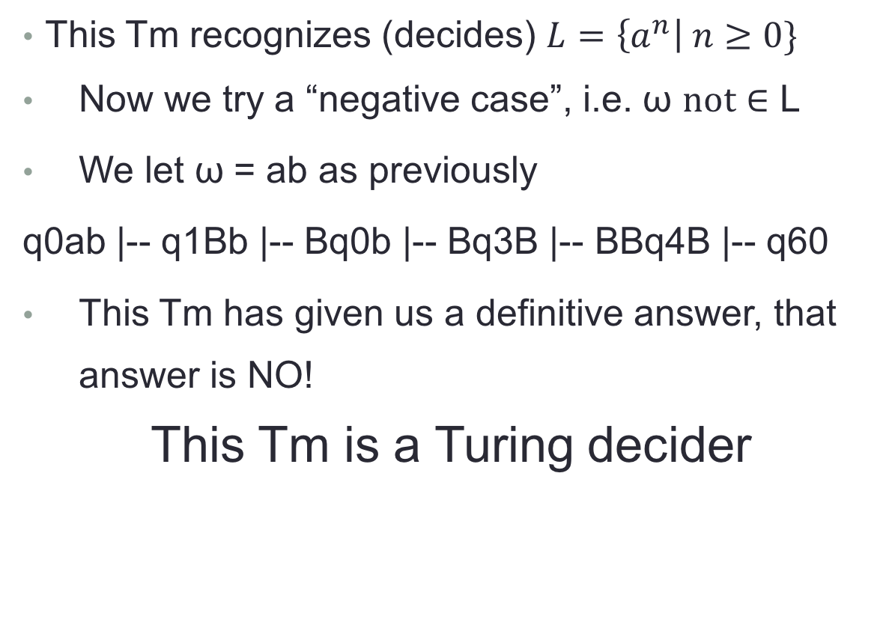
Example using figure 1.4.2 (b) cont’d

Slide 11
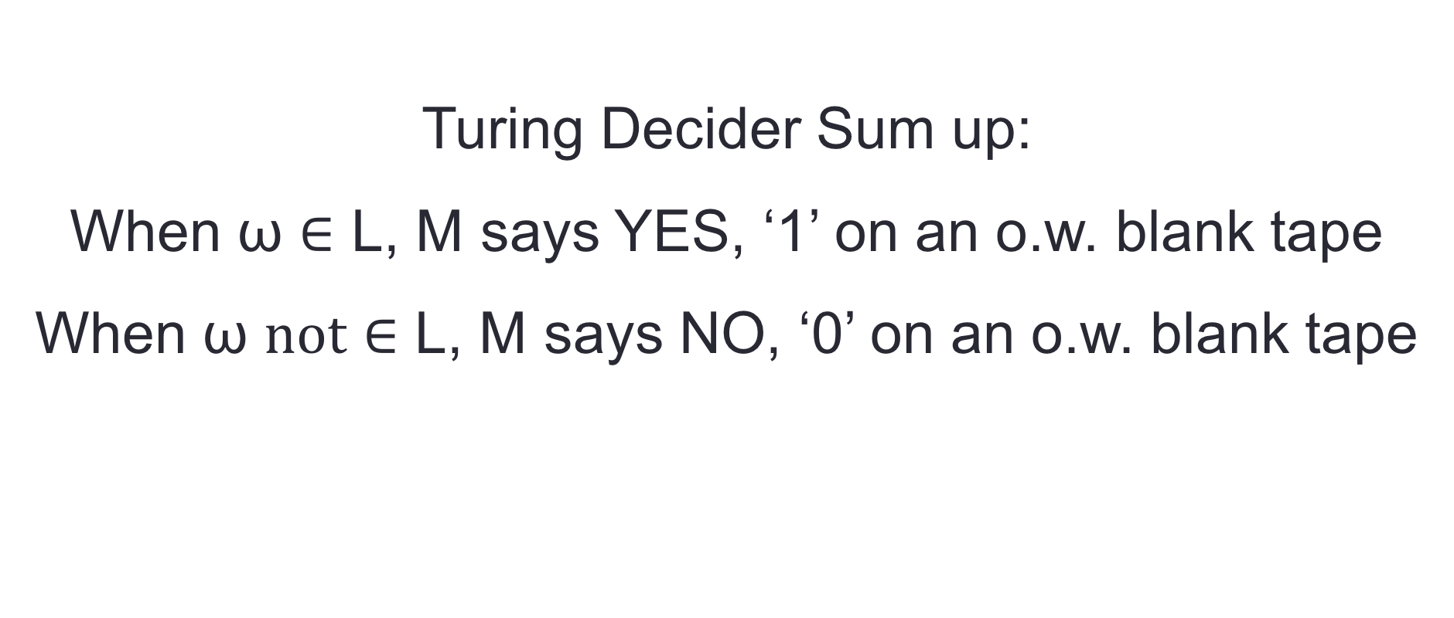
Turing Decider

Slide 12
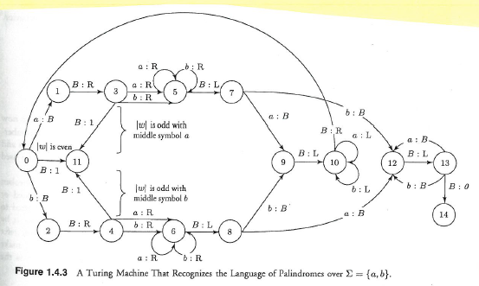
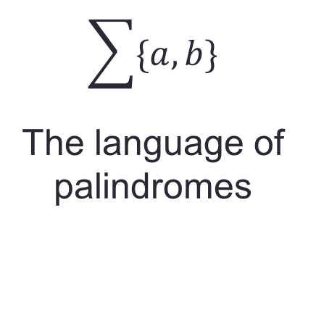
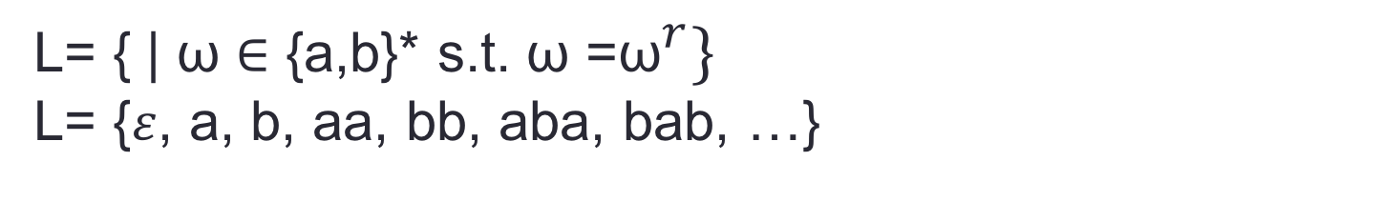
Example using figure 1.4.4

Slide 13
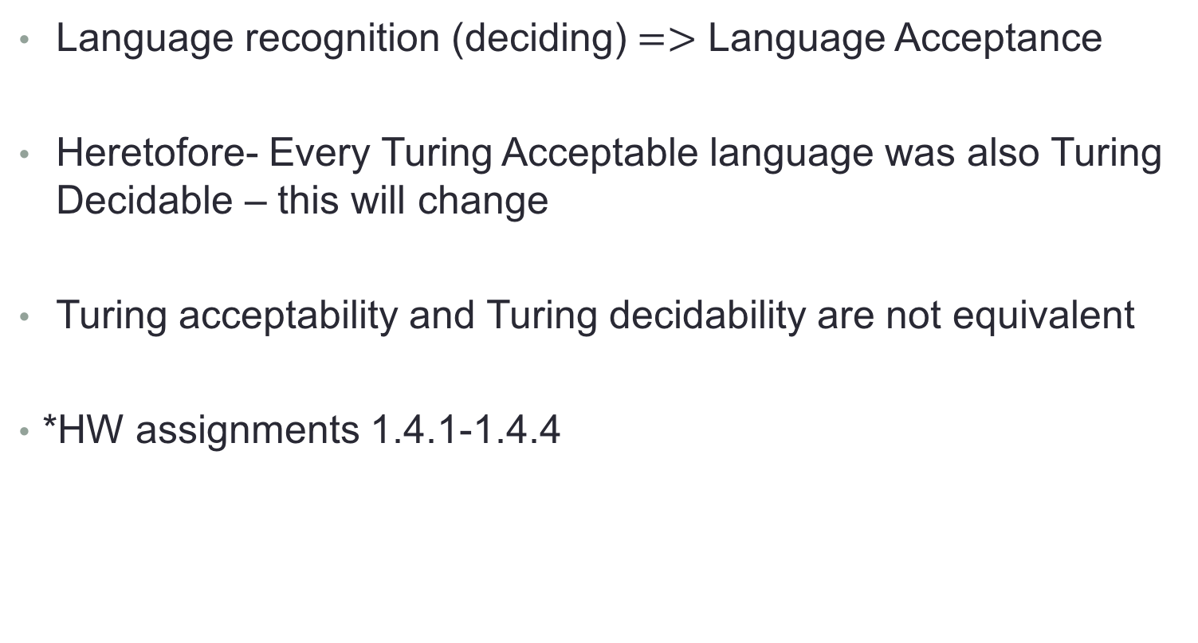
Concluding Remarks

